Slide 1

Chapter 12
Object Recognition
智能视觉理解
实验室

Slide 2
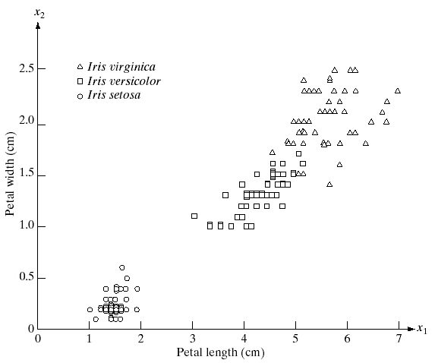
12.1 Patterns and Pattern Classes
Three types of iris flowers described by two measurements

Slide 3
12.1 Patterns and Pattern Classes
A pattern is an arrangement of descriptors
The name feature is used often in the pattern recognition literature to denote a descriptor
A pattern class is a family of patterns that share some common properties

Slide 4
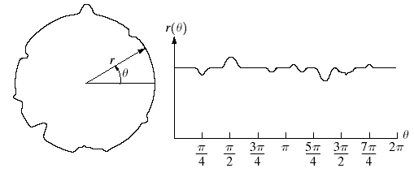
12.1 Patterns and Pattern Classes
Noisy Object and Signature
$$x_{1}=r\left(θ_{1}\right),x_{2}=r\left(θ_{2}\right),…,x_{n}=r\left(θ_{n}\right)$$

Slide 5
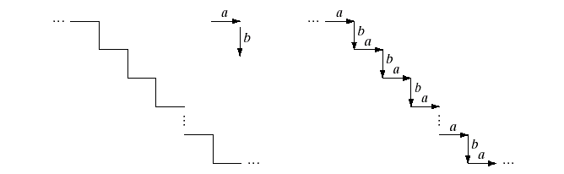
12.1 Patterns and Pattern Classes
Staircase Structure
String description
…abababa…

Slide 6
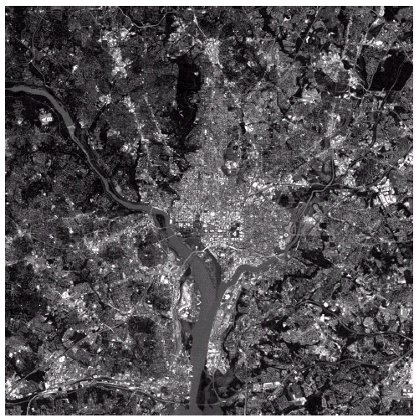
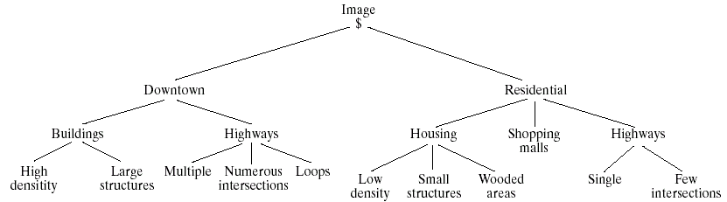
12.1 Patterns and Pattern Classes
Satellite image of a heavily built downtown area and surrounding residential areas.
Tree Description

Slide 7
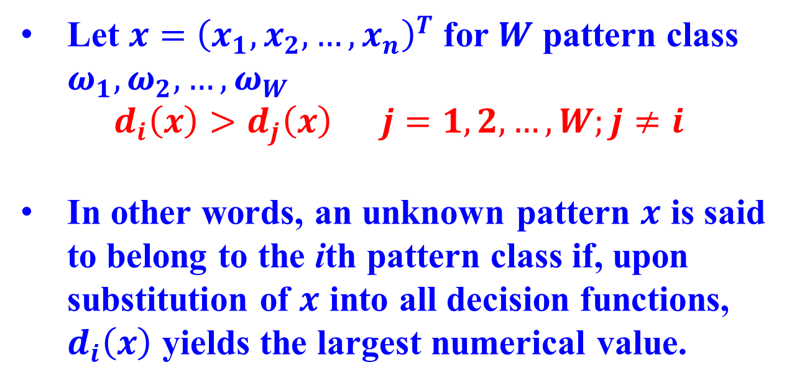
12.2 Recognition Based on Decision-Theoretic Methods
Let $x={\left(x_{1},x_{2},…, x_{n}\right)}^{T}$ for $W$ pattern class $ω_{1},ω_{2},…,ω_{W}$
$d_{i}\left(x\right)>d_{j}\left(x\right) j=1,2,…,W;j≠i$
In other words, an unknown pattern $x$ is said to belong to the ith pattern class if, upon substitution of $x$ into all decision functions, $d_{i}\left(x\right)$ yields the largest numerical value.

Slide 8
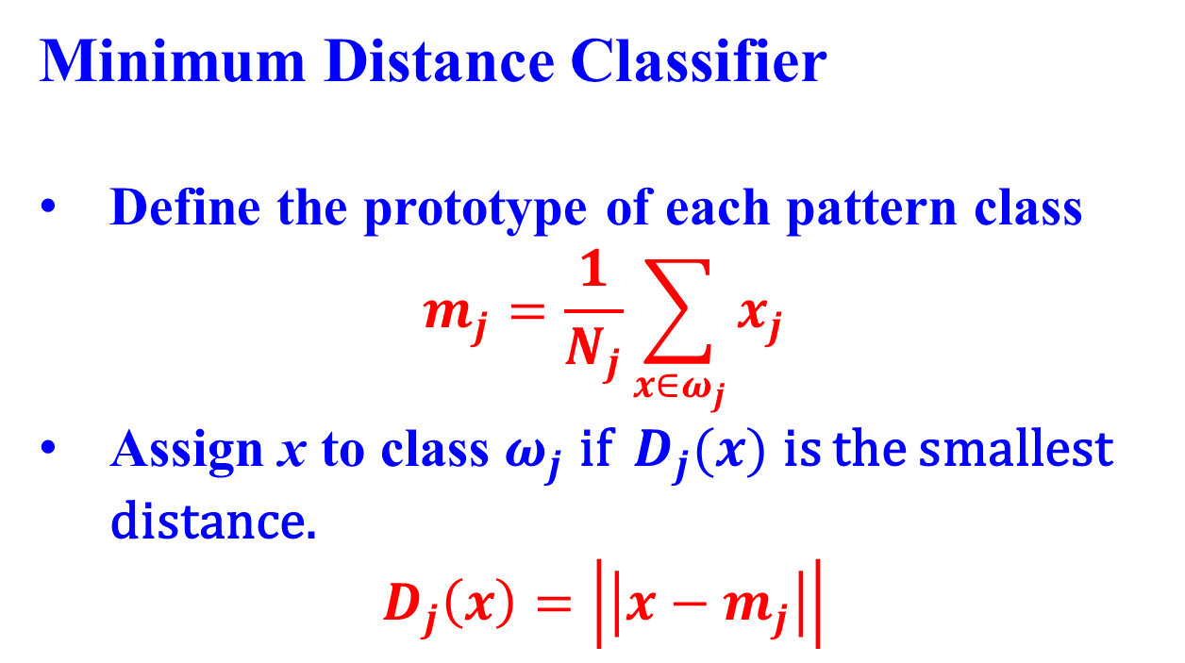
12.2.1 Matching
Minimum Distance Classifier
Define the prototype of each pattern class
$$m_{j}=\frac{1}{N_{j}}\sum_{x∈ω_{j}}{x_{j}}$$
Assign x to class $ω_{j}$ if ${ D}_{j}(x)$ is the smallest distance.
$$D_{j}\left(x\right)=\left|\left|x−m_{j}\right|\right|$$

Slide 9
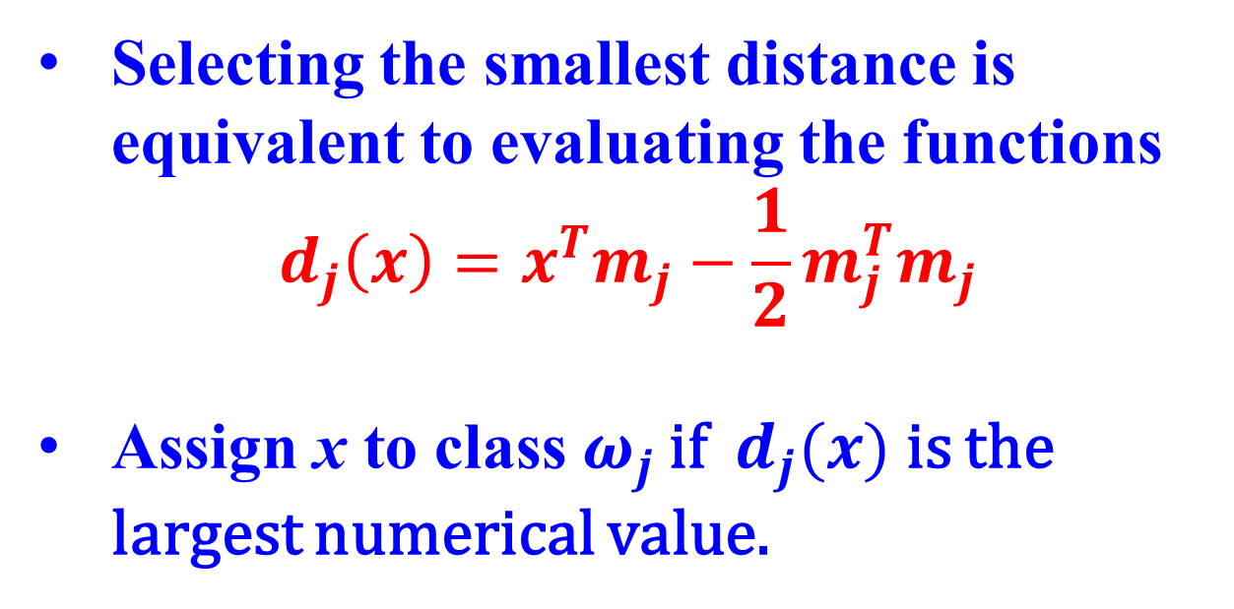
12.2.1 Matching
Selecting the smallest distance is equivalent to evaluating the functions
$$d_{j}\left(x\right)=x^{T}m_{j}−\frac{1}{2}m_{j}^{T}m_{j}$$
Assign x to class${ ω}_{j}$ if ${ d}_{j}(x)$ is the largest numerical value.

Slide 10
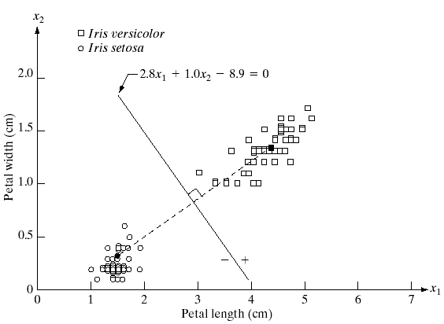
12.2.1 Matching
Decision boundary of minimum distance classifier. (Dark dot and square are the means)

Slide 11
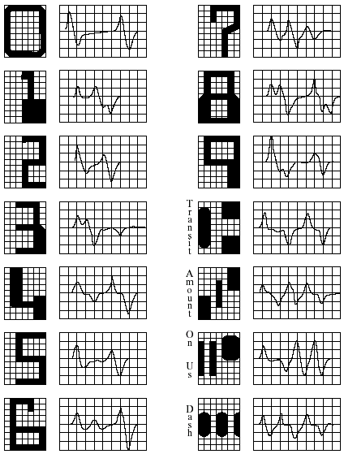
12.2.1 Matching
American Bankers Association E-13B font character set and corresponding waveforms.

Slide 12
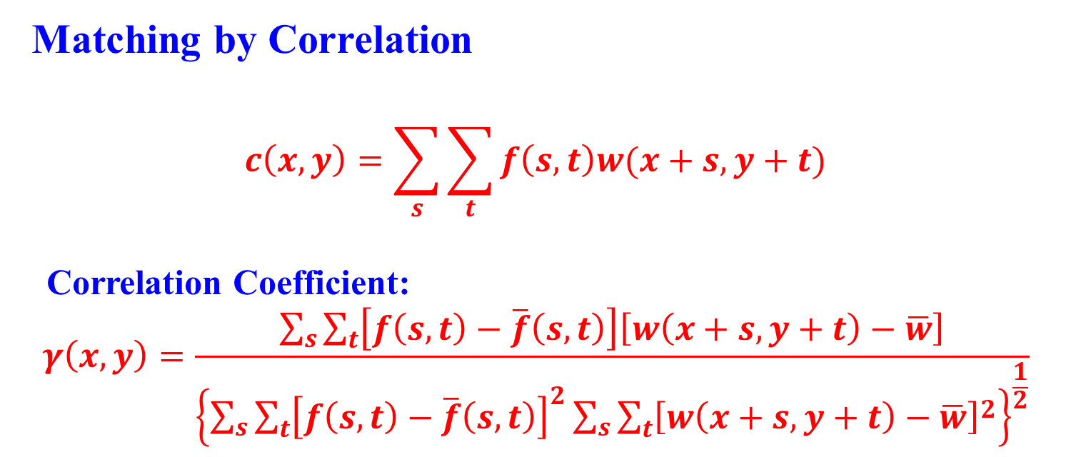
12.2.1 Matching
Matching by Correlation
$$c\left(x,y\right)=\sum_{s}{\sum_{t}{f\left(s,t\right)w(x+s, y+t)}}$$
Correlation Coefficient:
$$γ\left(x,y\right)=\frac{\sum_{s}{\sum_{t}{\left[f\left(s,t\right)−\overline{f}\left(s,t\right)\right]\left[w\left(x+s, y+t\right)−\overline{w}\right]}}}{{\left\{\sum_{s}{\sum_{t}{{\left[f\left(s,t\right)−\overline{f}\left(s,t\right)\right]}^{2}\sum_{s}{\sum_{t}{{\left[w\left(x+s, y+t\right)−\overline{w}\right]}^{2}}}}}\right\}}^{\frac{1}{2}}}$$

Slide 13
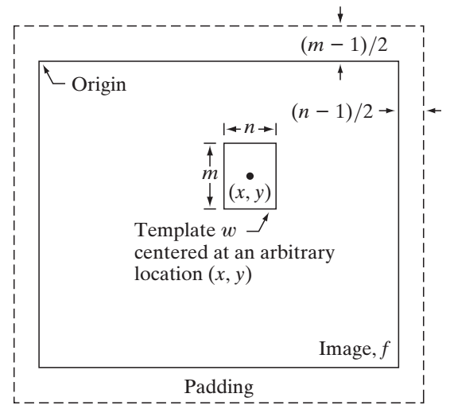
12.2.1 Matching
The mechanics of template matching

Slide 14
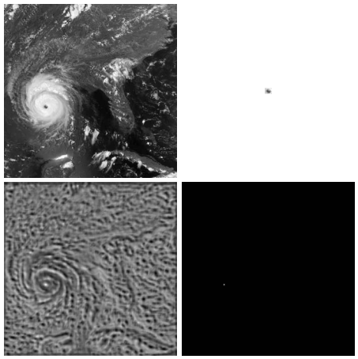
12.2.1 Matching
Satellite image
Template
Location of the best match
Correlation Coefficient

Slide 15
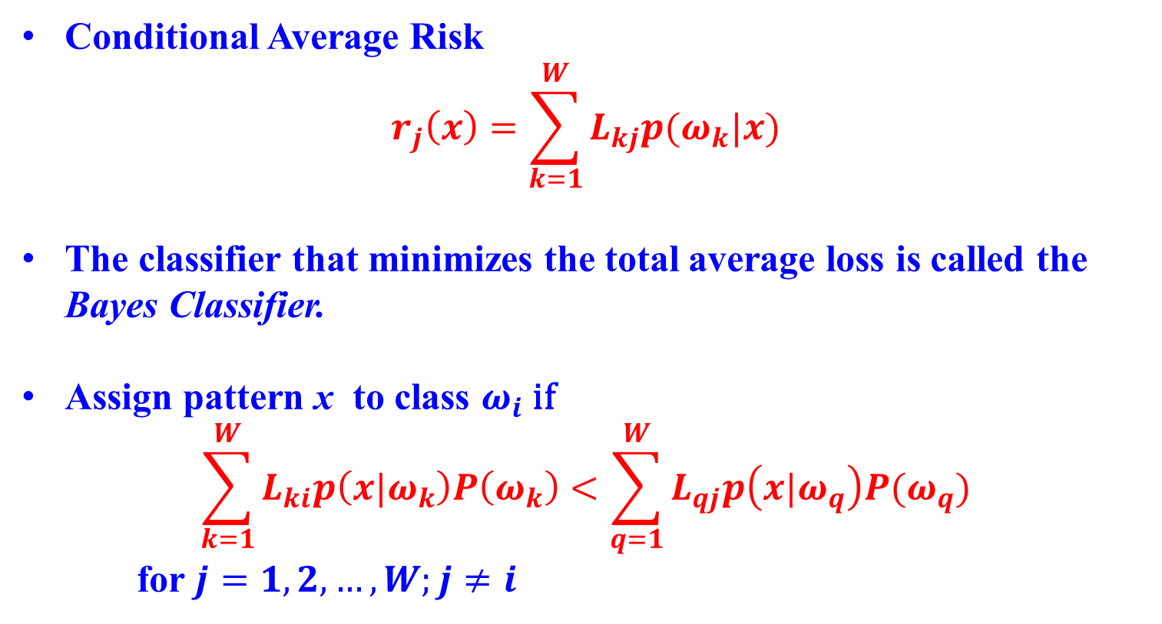
12.2.2 Optimum Statistical Classifiers
Conditional Average Risk
$$r_{j}\left(x\right)=\sum_{k=1}^{W}{L_{kj}p(ω_{k}|x)}$$
The classifier that minimizes the total average loss is called the Bayes Classifier.
Assign pattern x to class $ω_{i}$ if
$$\sum_{k=1}^{W}{L_{ki}p\left(x|ω_{k}\right)P\left(ω_{k}\right)<\sum_{q=1}^{W}{L_{qj}p\left(x|ω_{q}\right)P(ω_{q})}}$$
for $j=1,2,…,W;j≠i$

Slide 16
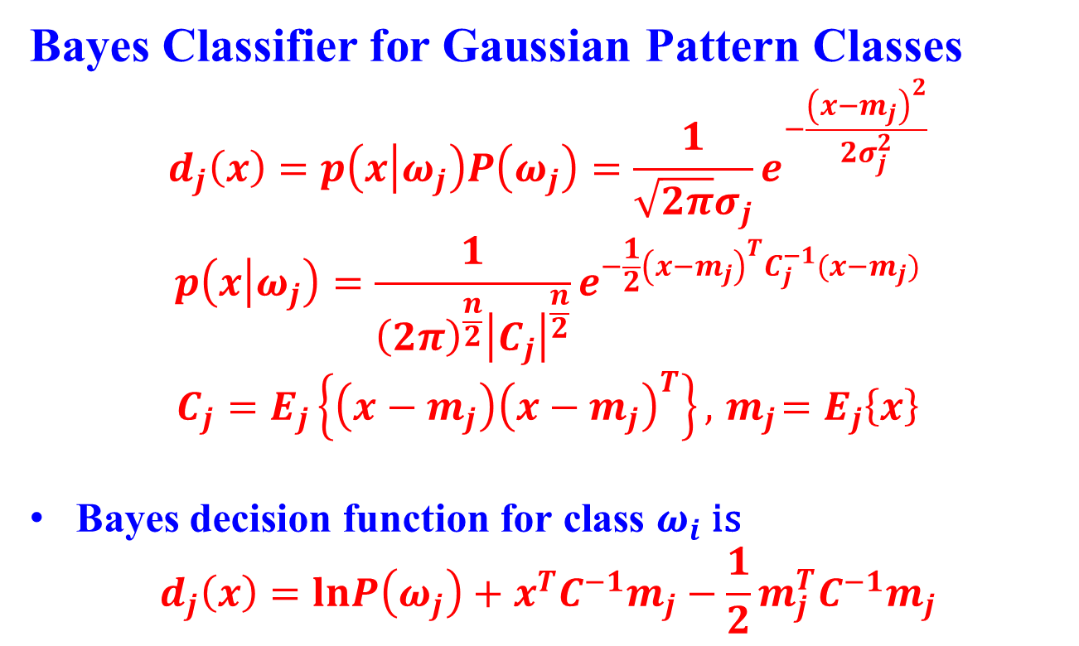
12.2.2 Optimum Statistical Classifiers
Bayes Classifier for Gaussian Pattern Classes
$$d_{j}\left(x\right)=p\left(x | ω_{j}\right)P\left(ω_{j}\right)=\frac{1}{\sqrt{2π}σ_{j}}e^{−\frac{{\left(x−m_{j}\right)}^{2}}{2σ_{j}^{2}}}$$
$$p\left(x | ω_{j}\right)=\frac{1}{{\left(2π\right)}^{\frac{n}{2}}{\left|C_{j}\right|}^{\frac{n}{2}}}e^{−\frac{1}{2}{\left(x−m_{j}\right)}^{T}C_{j}^{−1}(x−m_{j})}$$
$$C_{j}=E_{j}\left\{\left(x−m_{j}\right){\left(x−m_{j}\right)}^{T}\right\}, { m}_{j}=E_{j}\left\{x\right\}$$
Bayes decision function for class $ω_{i}$ is
$$d_{j}\left(x\right)=lnP\left(ω_{j}\right)+x^{T}C^{−1}m_{j}−\frac{1}{2}m_{j}^{T}C^{−1}m_{j}$$

Slide 17
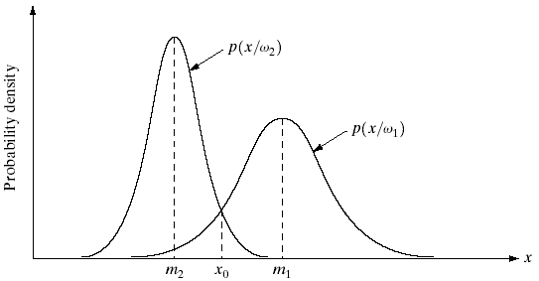
12.2.2 Optimum Statistical Classifiers
Probability density functions for two 1-D pattern classes. The point x₀ shown is the decision boundary if the two classes are equally likely to occur.

Slide 18
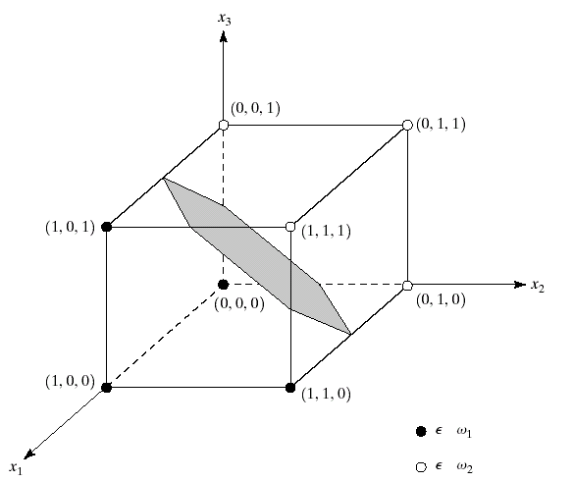
12.2.2 Optimum Statistical Classifiers
Two Simple Pattern Classes and their Bayes Decision Boundary

Slide 19
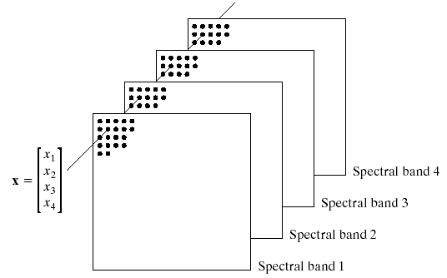
12.2.2 Optimum Statistical Classifiers
Formation of a pattern vector from registered pixels of four digital images generated by a multispectral scanner.

Slide 20
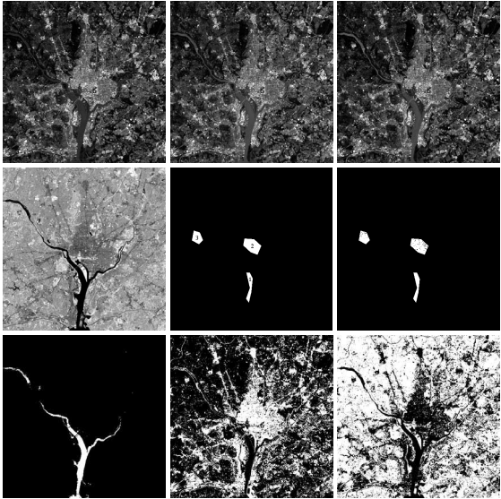
Visible Blue
Visible Green
Visible Red
Near Infrared Wavelengths
Mask
Result of Classification
All Classified as Water
As Urban development
As Vegetations

Slide 21
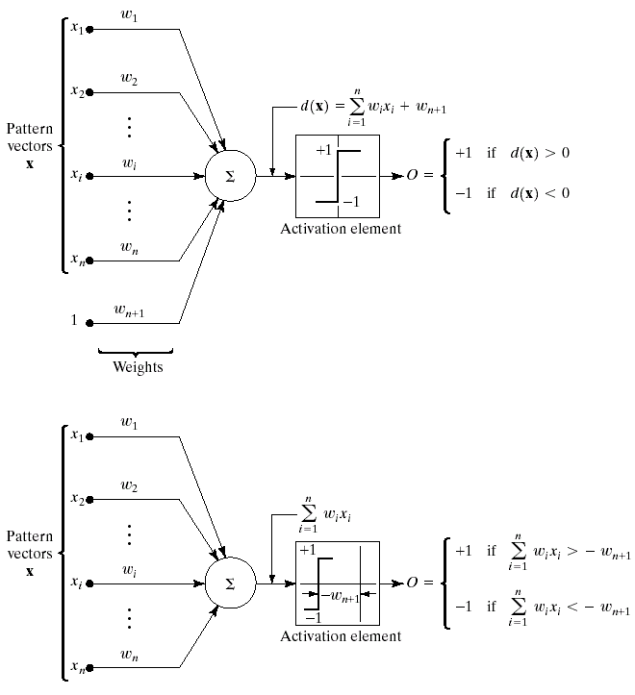
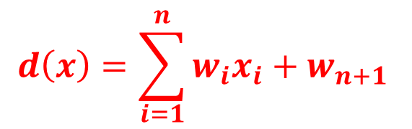
12.2.3 Neural Networks
$$d\left(x\right)=\sum_{i=1}^{n}{w_{i}x_{i}+w_{n+1 }}$$
Two equivalent representations of the perceptron model for two pattern classes

Slide 22
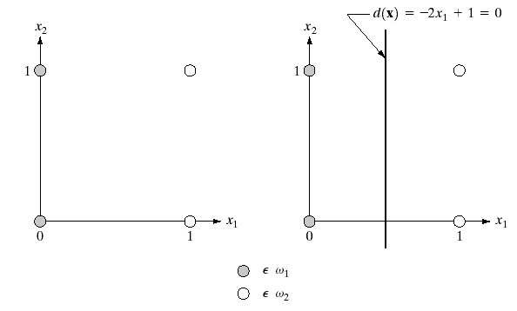
12.2.3 Neural Networks
Patterns Belonging to Two Classes
Decision Boundary

Slide 23
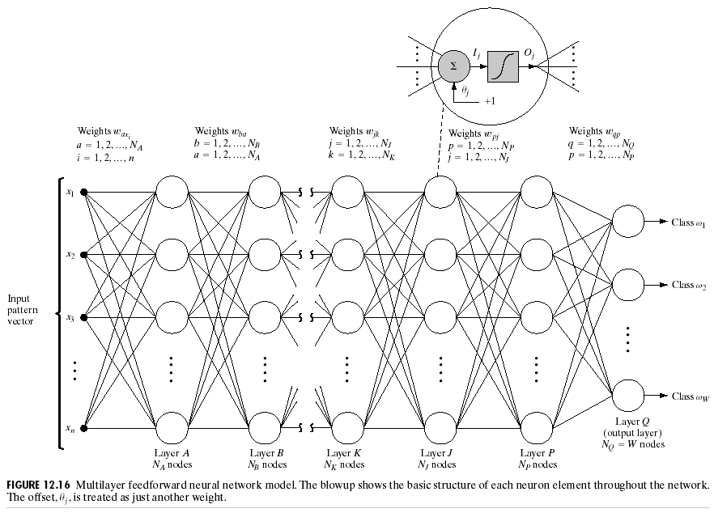
12.2.3 Neural Networks
Multilayer Feedforward Neural Network

Slide 24
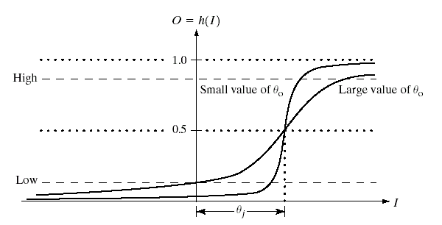
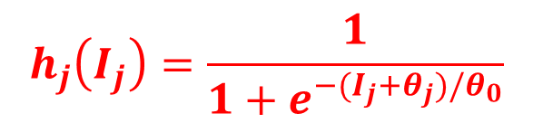
12.2.3 Neural Networks
Sigmoidal Activation
$$h_{j}\left(I_{j}\right)=\frac{1}{1+e^{−(I_{j}+θ_{j})/θ_{0}}}$$

Slide 25
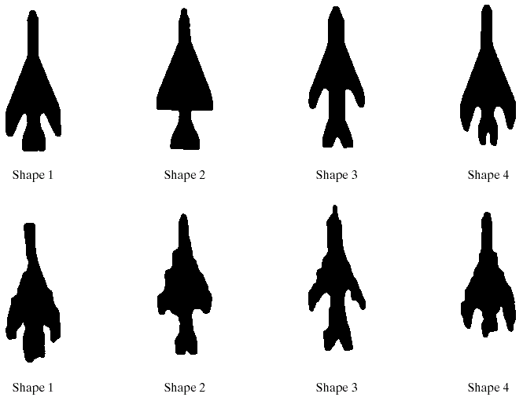
12.2.3 Neural Networks
Reference Shapes
Typical Noisy Shapes Used in Training

Slide 26
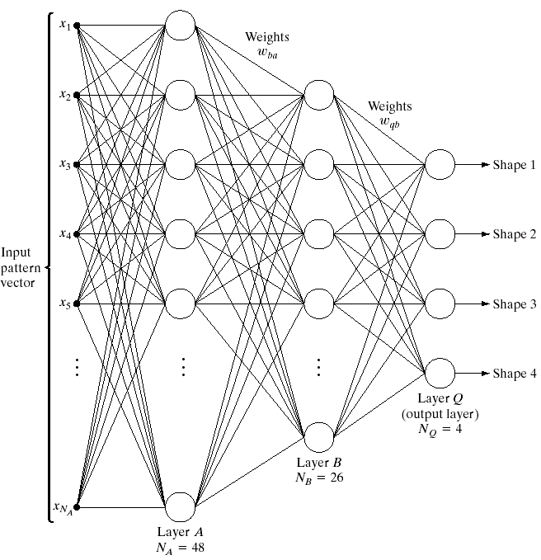
12.2.3 Neural Networks
Three-layer Neural Network

Slide 27
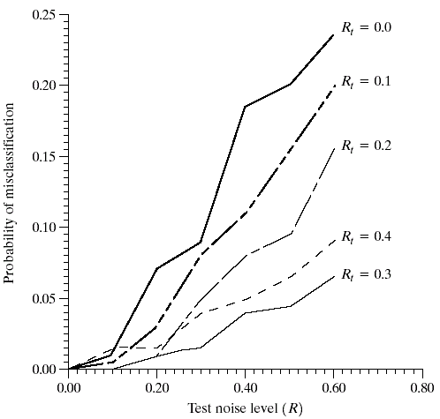
12.2.3 Neural Networks
Performance of the neural network as a function of noise level.

Slide 28
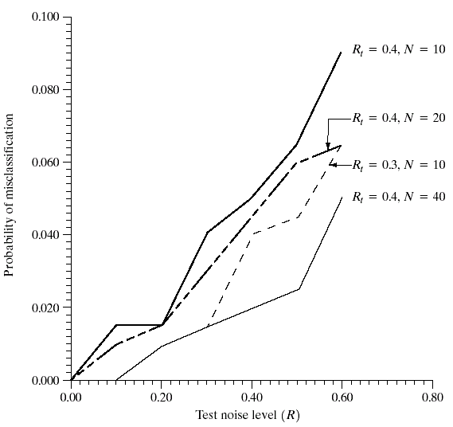
12.2.3 Neural Networks
Improvement in performance for R_{t}=0.4 by increasing the number of training patterns (the curve for R_{t}=0.3 is shown for reference).

Slide 29
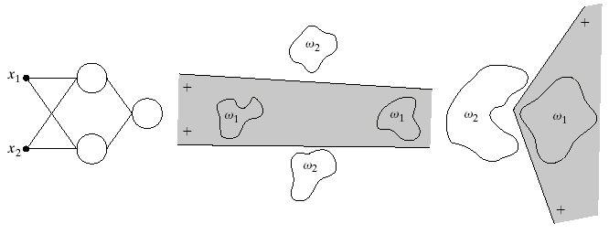
12.2.3 Neural Networks
Two-input Two-layer
Examples of Decision Boundaries

Slide 30
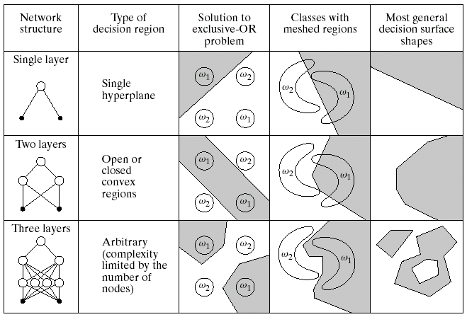
Types of decision regions that can be formed by single- and multilayer feedforward neural networks.

Slide 31
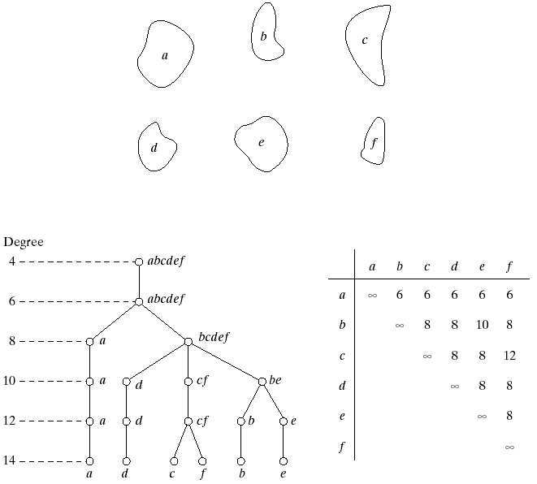
12.3.1 Matching Shape Number
Shapes
Hypothetical Similarity Tree
Similarity Matrix

Slide 32
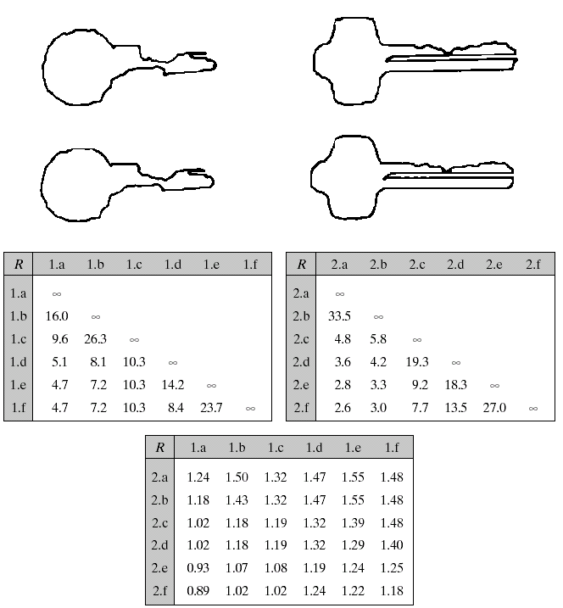
12.3.2 String Matching
Sample boundaries of two different object classes
Polygonal approximations
Tabulations of R

Slide 33
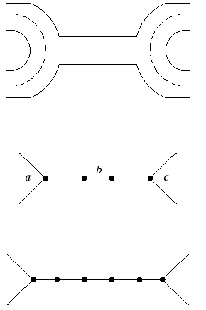
12.3.3 Syntactic Recognition of Strings

Slide 34
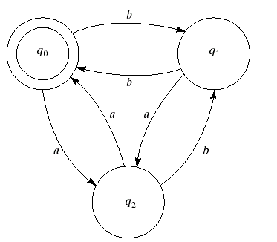
12.3.3 Syntactic Recognition of Strings
Finite Automaton

Slide 35
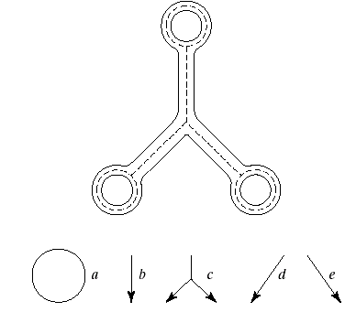
12.3.4 Syntactic Recognition of Tree
Primitives

Slide 36
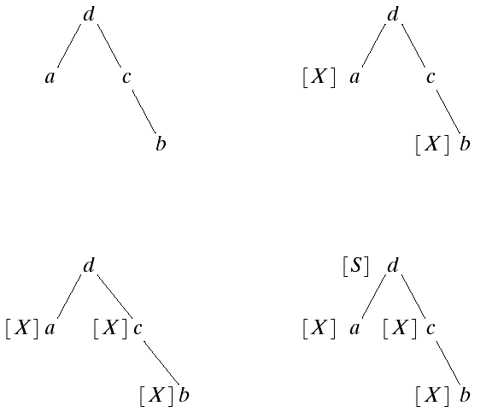
12.3.4 Syntactic Recognition of Tree
Processing Stages of a Frontier-to-root Tree

Slide 37
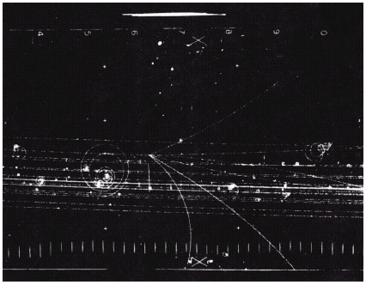
12.3.4 Syntactic Recognition of Tree
A Bubble Chamber Photograph

Slide 38
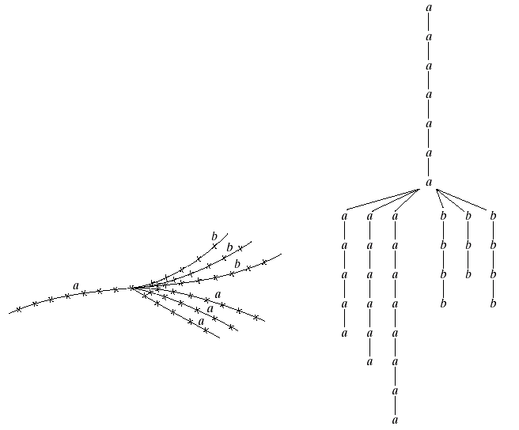
12.3.4 Syntactic Recognition of Tree
Tree Representation
Coded Event

Slide 39
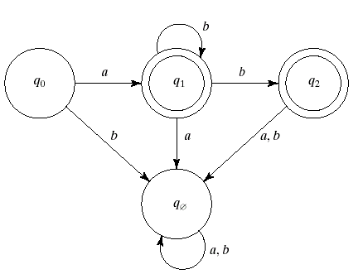
12.3.4 Syntactic Recognition of Tree
State Diagram

Slide 40
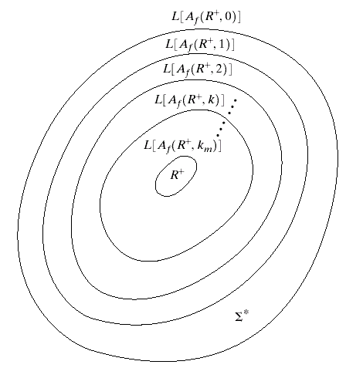

Slide 41
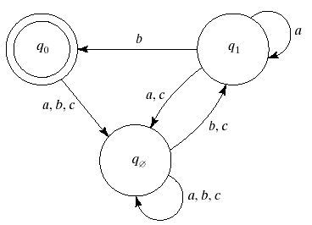
12.3.4 Syntactic Recognition of Tree
State Diagram for A_{f} (R+, 1)

Slide 42

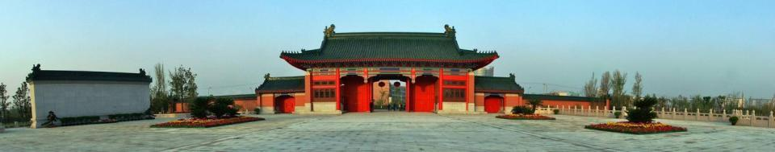
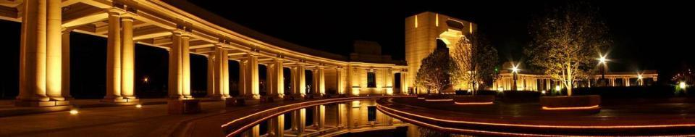
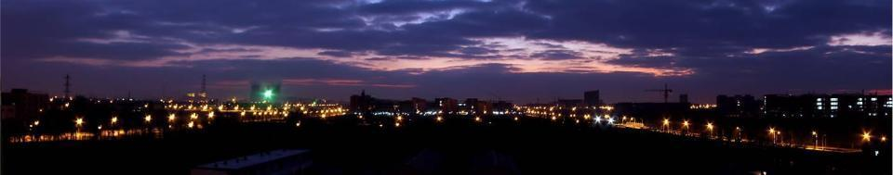
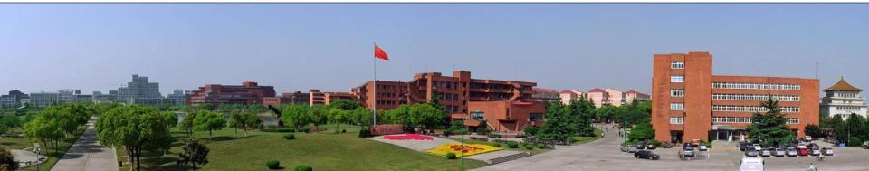
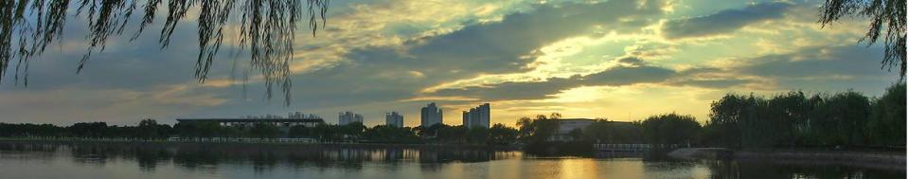
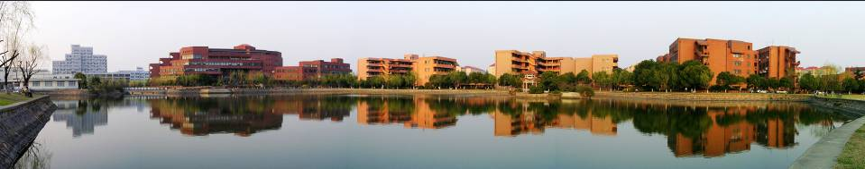
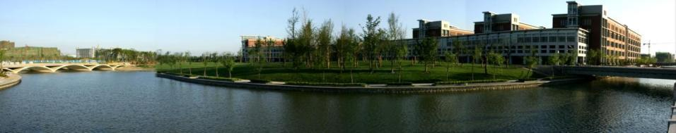
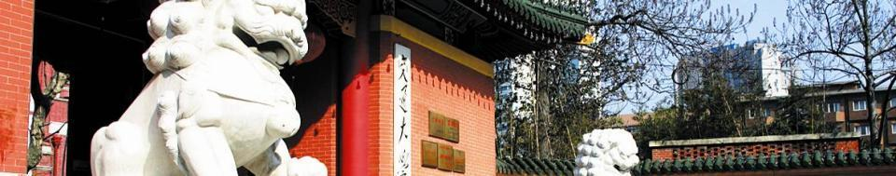
智能视觉理解
实验室

